Slide 1

Title: Personalized Fitness and Health Awareness Tracker
Student Name: Hamsika Peddina
Student ID: 2520030586
Cluster:2
Section: 8
Under the Guidance
of
Supervisor Name: Jayaram Boga
Assistant Professor
Department of CSE

Slide 2
OUTLINE
Abstract
Existing System
Proposed System
System Architecture
Project Modules
Objectives
Co’s Attainments - FWD
Co1
Co2 …….. 5. Co5
Screen Shots for FWD
Conclusion
Geo-Tagged Photos

Slide 3
Abstract
The Personalized Fitness and Health Awareness App is a web-based application designed to promote fitness and lifestyle awareness through personalized health insights. The system calculates the user’s Body Mass Index (BMI) and ideal body weight using inputs such as height, weight, age, and gender, and categorizes users into standard health groups.
A health summary dashboard visually presents BMI results, ideal weight range, and progress history, enabling users to clearly understand their current fitness status and track changes over time. In addition to health assessment, the application integrates mood and energy level inputs to provide personalized fitness suggestions, general diet plan recommendations, and a weekly activity planner.
Diet plans are offered as basic lifestyle guidance based on BMI category and user goals, ensuring the system remains informative rather than medical in nature. The application also includes goal setting, lifestyle tips, and motivational messages to enhance user engagement.
Designed using modern web technologies with a responsive and user-friendly interface, this project emphasizes fitness awareness, usability, and frontend design principles, making it suitable for strong real-world relevance.

Slide 4
Existing System
Focus on only one aspect such as calories or step tracking
Require external devices or subscriptions
Provide limited personalized insights
Do not integrate mood, lifestyle, and fitness planning together
Some applications are complex for beginners
Meal plans and calorie targets are based on Western diets and do not account for Indian food culture or traditional meal names
Commercial apps show advertisements and push premium subscriptions, reducing accessibility

Slide 5
Proposed System
BMI calculation and tracking
Personalized diet recommendations
Personalized fitness planning
Daily habit tracking (water, exercise, sleep)
Goal progress monitoring
Health analytics using charts
Reminder system for healthy habits
Achievement system to motivate users
Combines multiple aspects of fitness, lifestyle, and behavioral insights into a single accessible web application

Slide 6
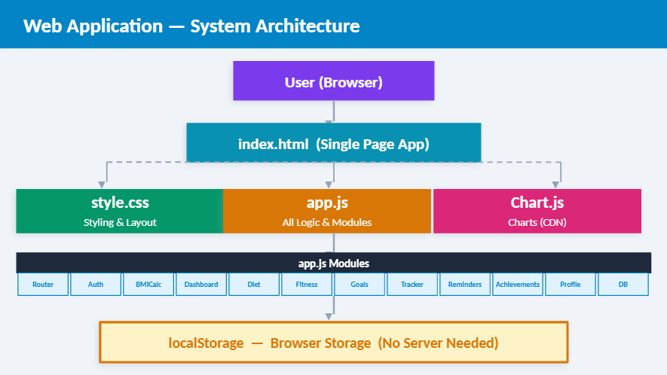
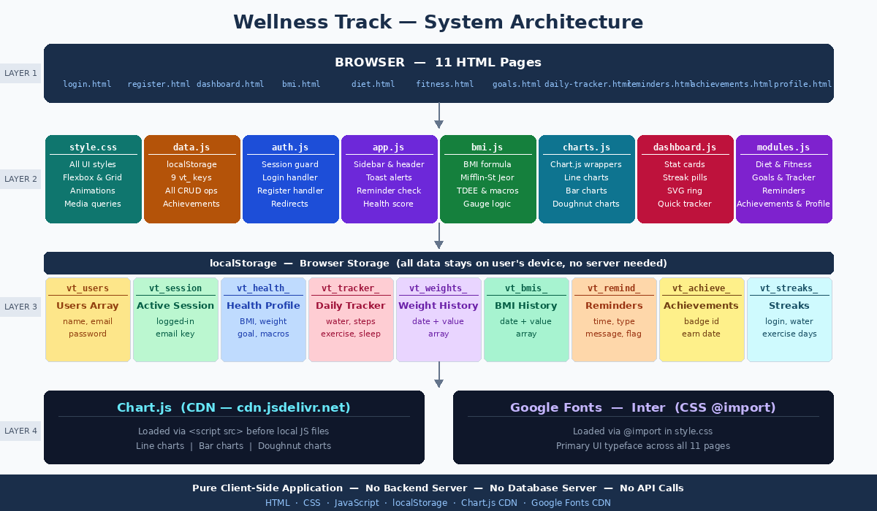
System Architecture

Slide 7
Project Modules
Module 1 — Authentication (login.html, register.html, auth.js, data.js) Register and login with email/password.
Module 2 — BMI & Health Calculator (bmi.html, bmi.js, charts.js) cm/ft height toggle. Mifflin-St Jeor BMR formula. TDEE with 5 activity multipliers. Calorie adjustment by goal.
Module 3 — Indian Diet Plan (diet.html, modules.js) 3 goal-based Indian meal plans (Lose/Maintain/Gain).
Module 4 — Fitness Plan (fitness.html, modules.js) 7-day workout schedule per goal. Types: cardio, strength, HIIT, rest. Intensity bar chart and workout distribution doughnut chart.

Slide 8
Module 5 — Goal Tracking (goals.html, modules.js) Tracks BMI progress toward target. Animated SVG ring, 5 milestones, weekly projection alert. Unlocks goal_achieved badge at 100%.
Module 6 — Daily Habit Tracker (daily-tracker.html, modules.js) Tracks water, exercise, steps, and sleep. Health score 0–100. Toast notification when goal hit.
Module 7 — Reminders (reminders.html, modules.js) 5 reminder types checked. Unlocks reminder_pro badge at 3+ reminders.
Module 8 — Achievements (achievements.html, modules.js) 12 badges auto-unlocked by checkTrackerAchievements on every data update. Earned shown in colour, locked greyed out.
Module 9 — User Profile (profile.html, modules.js) Edit health details, recalculates all metrics on save. Shows initials avatar and badge count.

Slide 9
Objectives
Promote Health Awareness
Provide Personalized Health Insights
Enable Health Data Monitoring
Encourage Healthy Daily Habits
Support Goal-Based Fitness Tracking
Provide Visual Health Analytics
Improve User Engagement Through Reminders and Achievements
Build an Accessible Web-Based Health Tool

Slide 10
Co’s Attainments - FWD
CO1 | Semantic HTML5 on all 11 pages. HTTP/HTTPS via CDN links. localStorage as client-side database. CSS selectors, typography, hex colors, custom properties, and spacing in style.css
CO2 | 6 forms with validation. Semantic tags throughout. Flexbox, CSS Grid, media queries at 1100/900/600px, CSS animations for SVG rings and BMI gauge, CSS custom properties for theming
CO3 | Arrow functions and callbacks in all 7 JS files. Conditions and loops for BMR, score, and streak logic. Array methods (forEach, map, filter, find) across data.js and modules.js
CO4 | Full DOM manipulation and event handling. localStorage for all data. setInterval for async reminder checks. Chart.js integrated via CDN with dynamic datasets from localStorage
CO5 | try-catch on localStorage and form inputs. Dynamic content rendering. Meta tags on all pages. Scripts deferred to bottom of body. Project structured for Express.js deployment

Slide 11
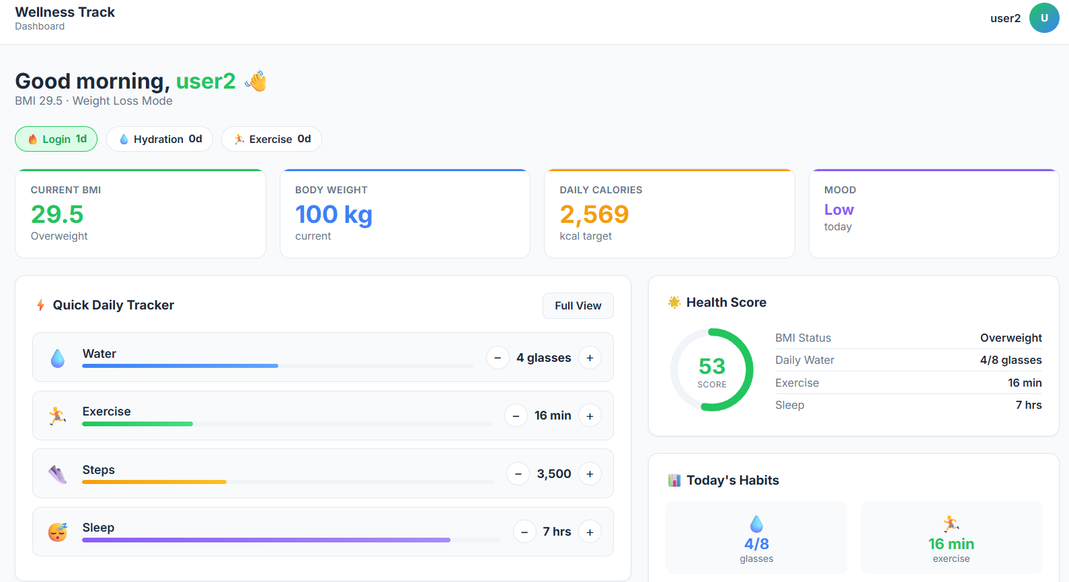
Screenshots for FWD

Slide 12
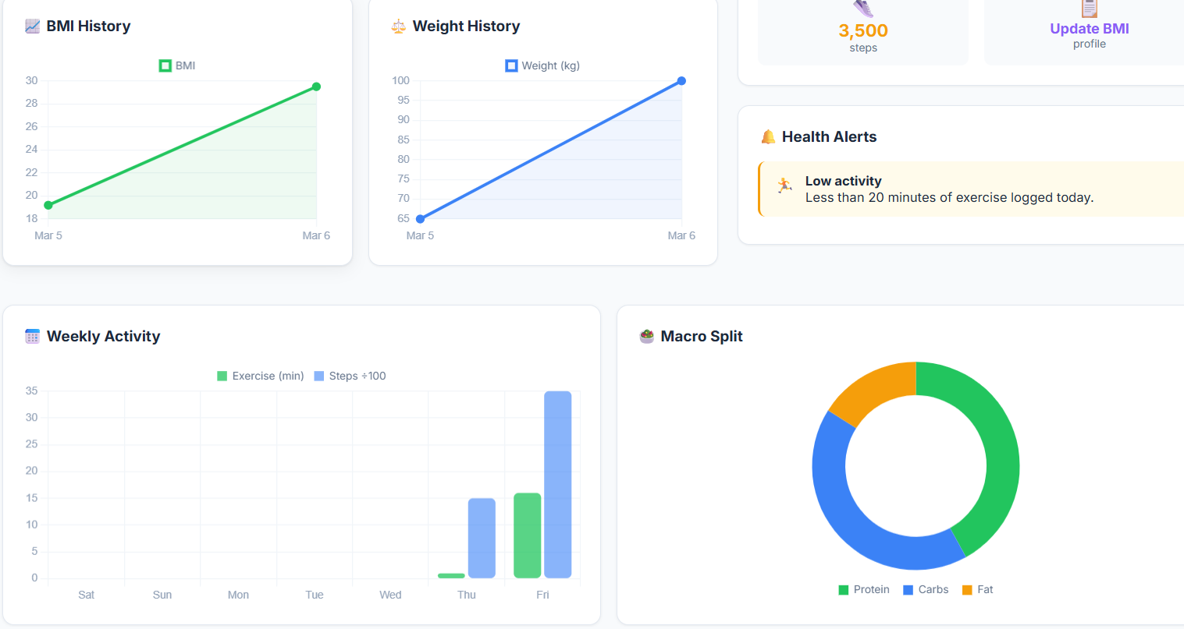

Slide 13
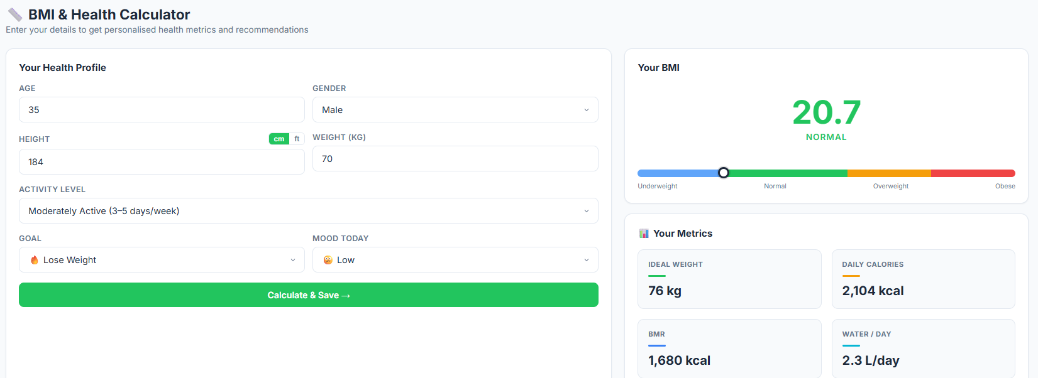

Slide 14
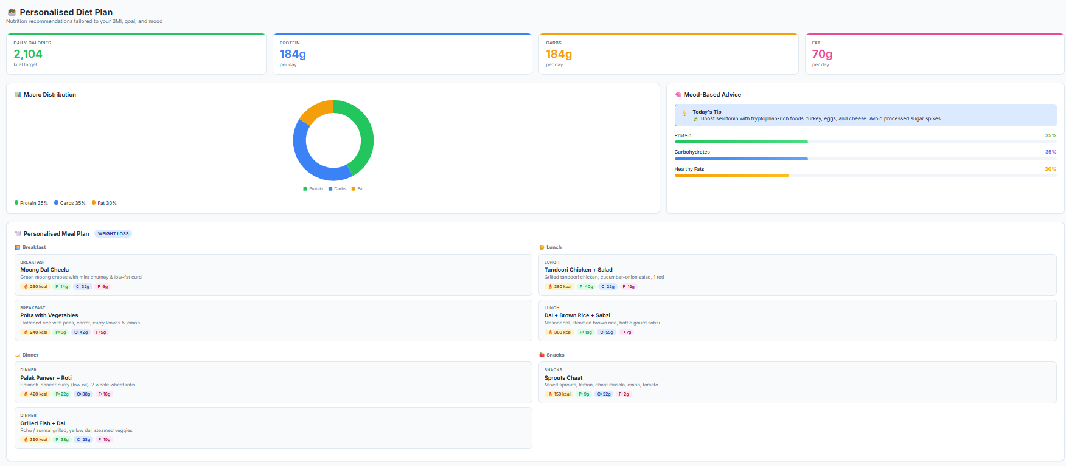

Slide 15
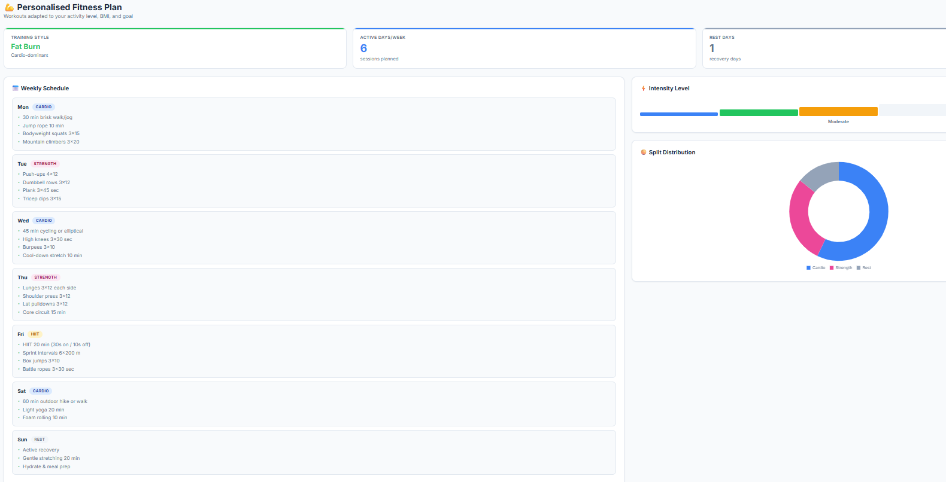

Slide 16
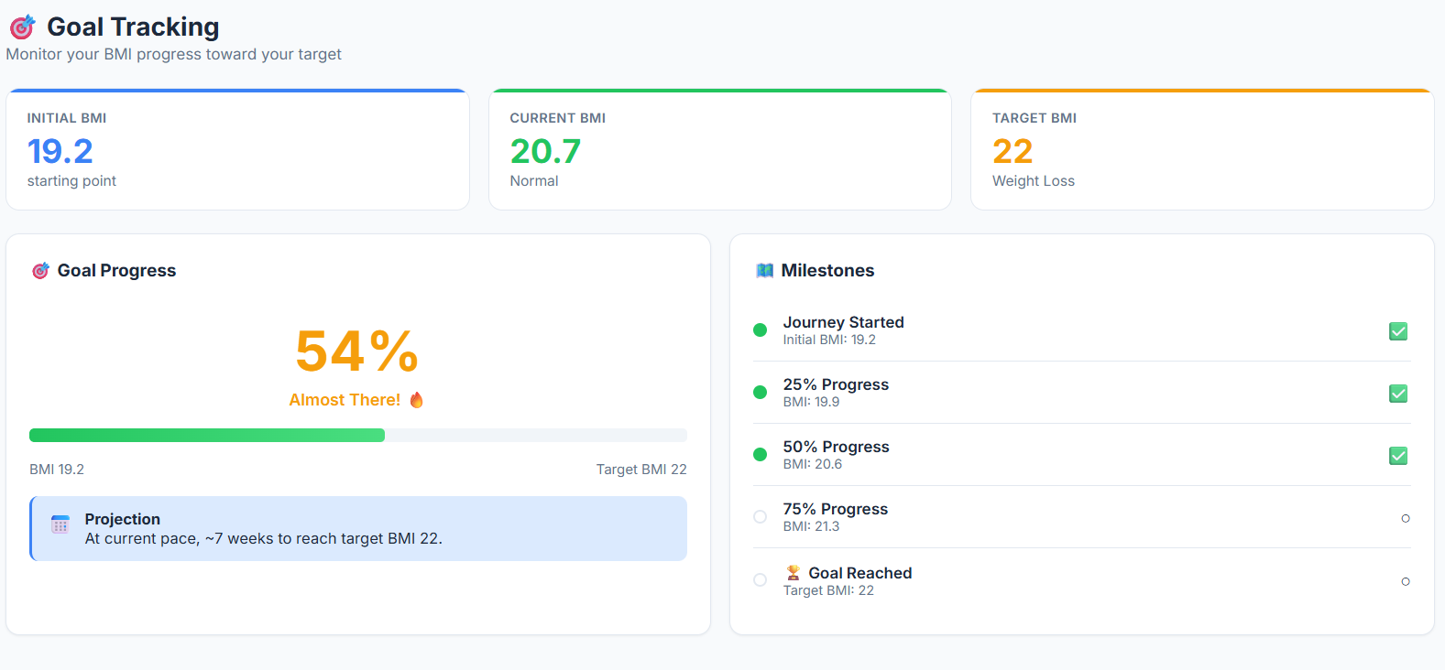

Slide 17
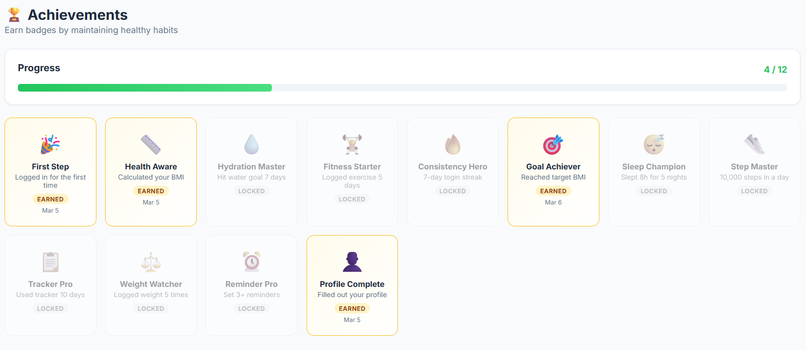

Slide 18
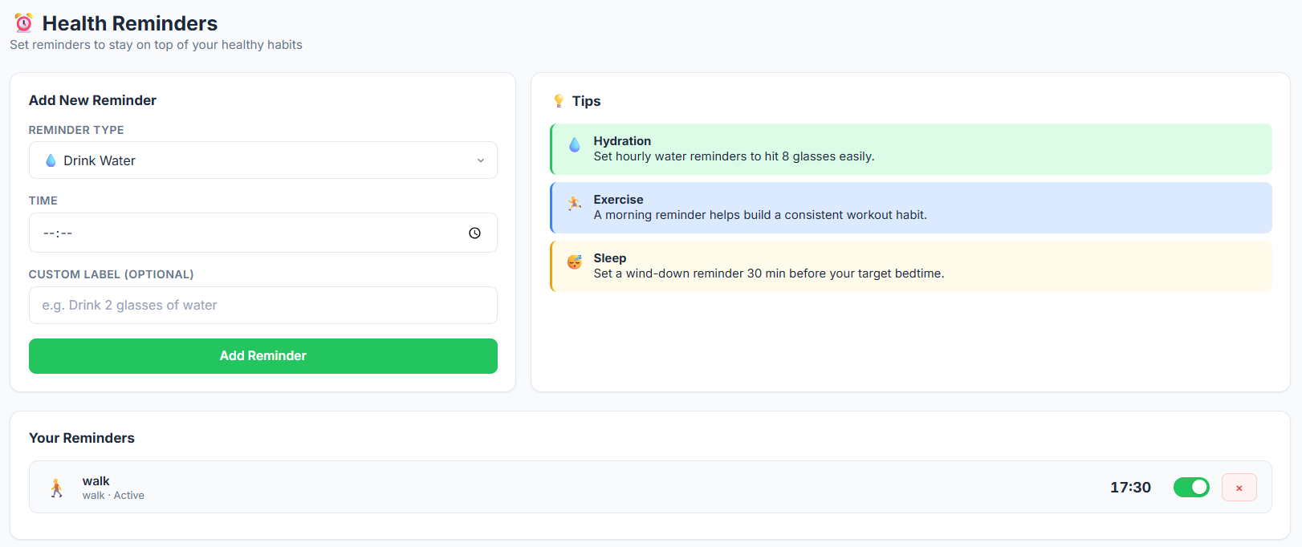

Slide 19
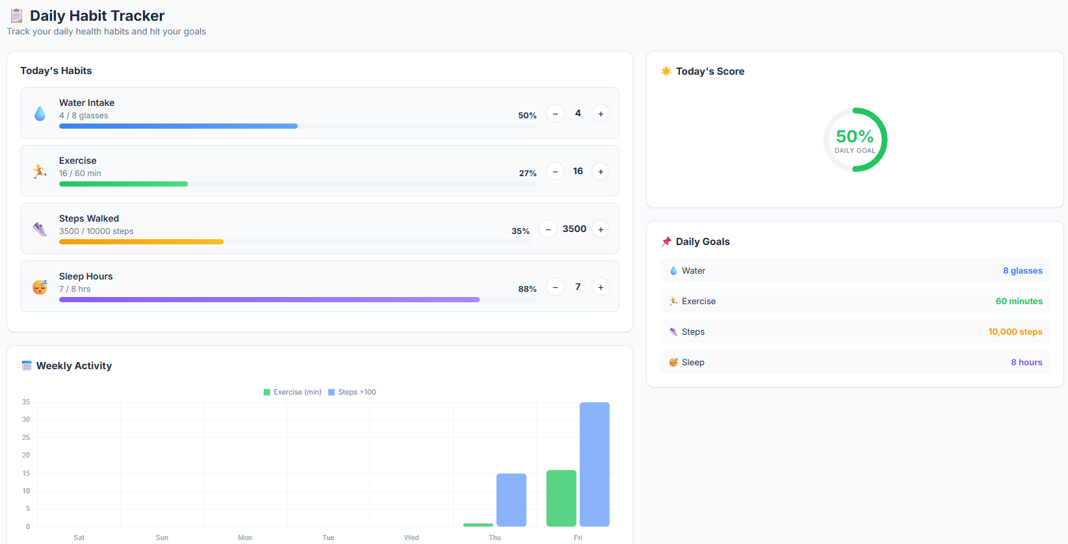

Slide 20
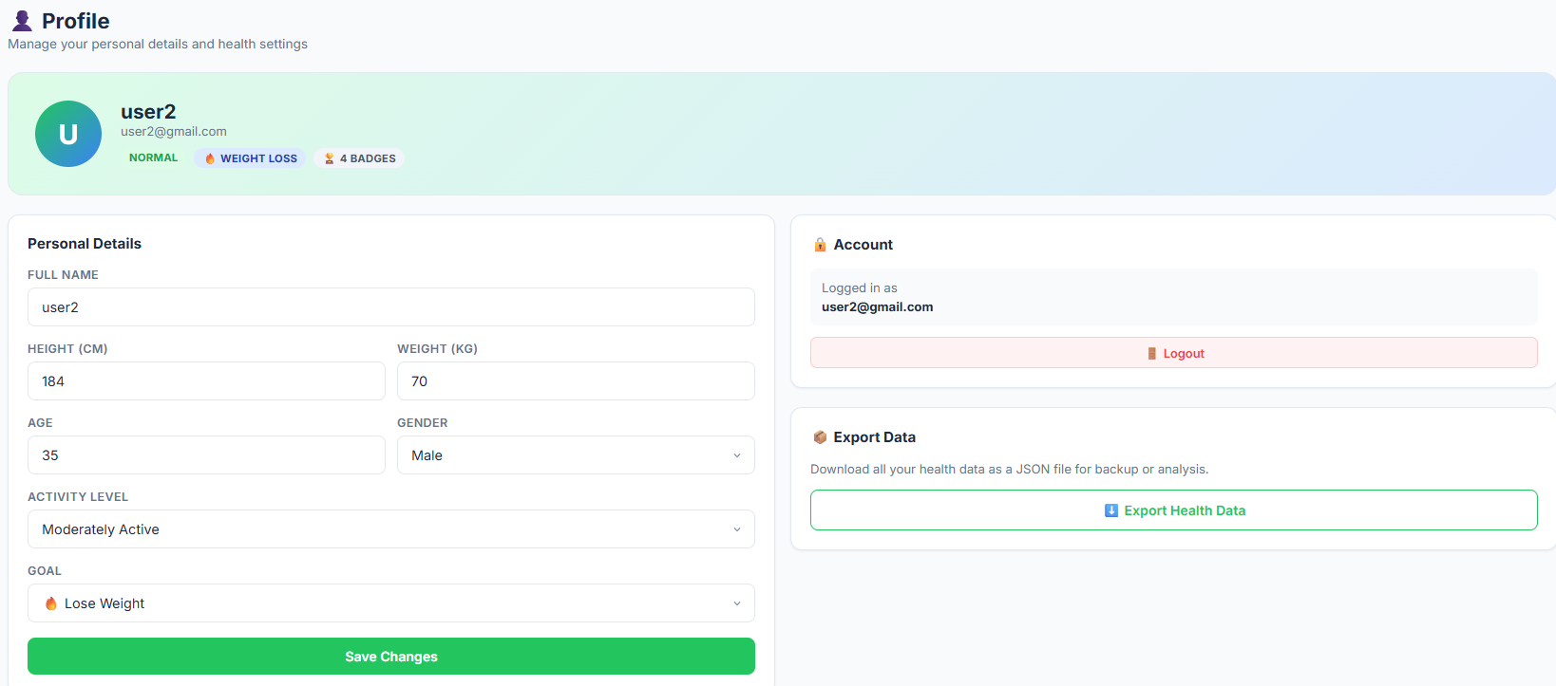

Slide 21
Conclusion
The Personalized Fitness and Health Awareness Tracker is a web-based application that helps users monitor and improve their health through features such as BMI tracking, personalized diet and fitness recommendations, daily habit tracking, and goal progress monitoring.
The system provides health insights using interactive charts and reminders to encourage healthy habits.
Wellness Track successfully delivers a privacy-first 11-page health tracking web application. The web app works fully offline with all data in localStorage, uses Indian meal plans, and integrates Charts for visualisations.
Built using HTML, CSS, and JavaScript, the application demonstrates practical web development skills while promoting health awareness in a simple and accessible way.

Slide 22
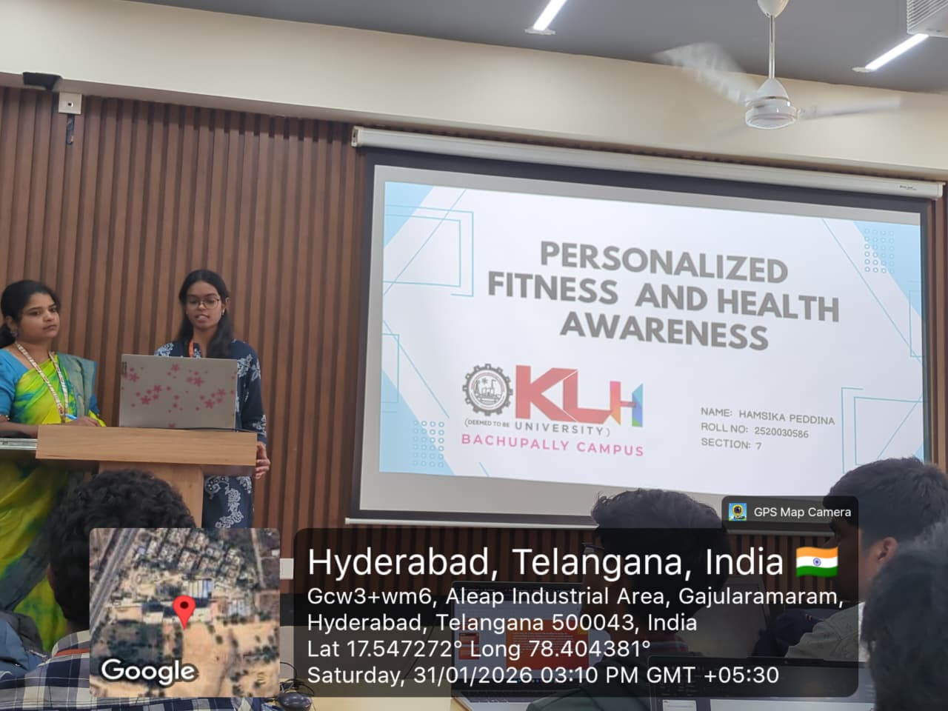
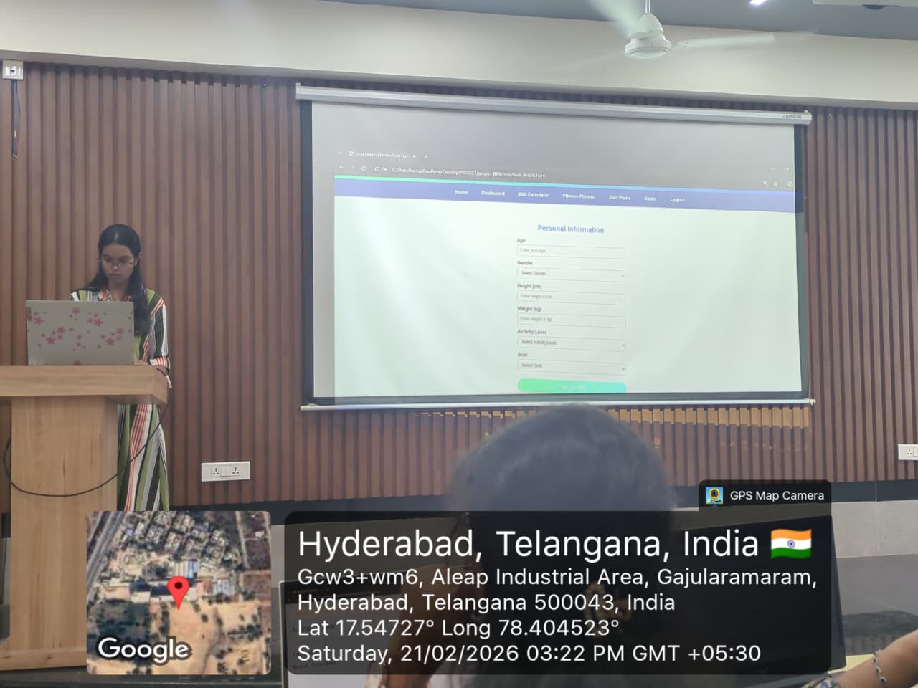
Geo- Tag Photos

Slide 23
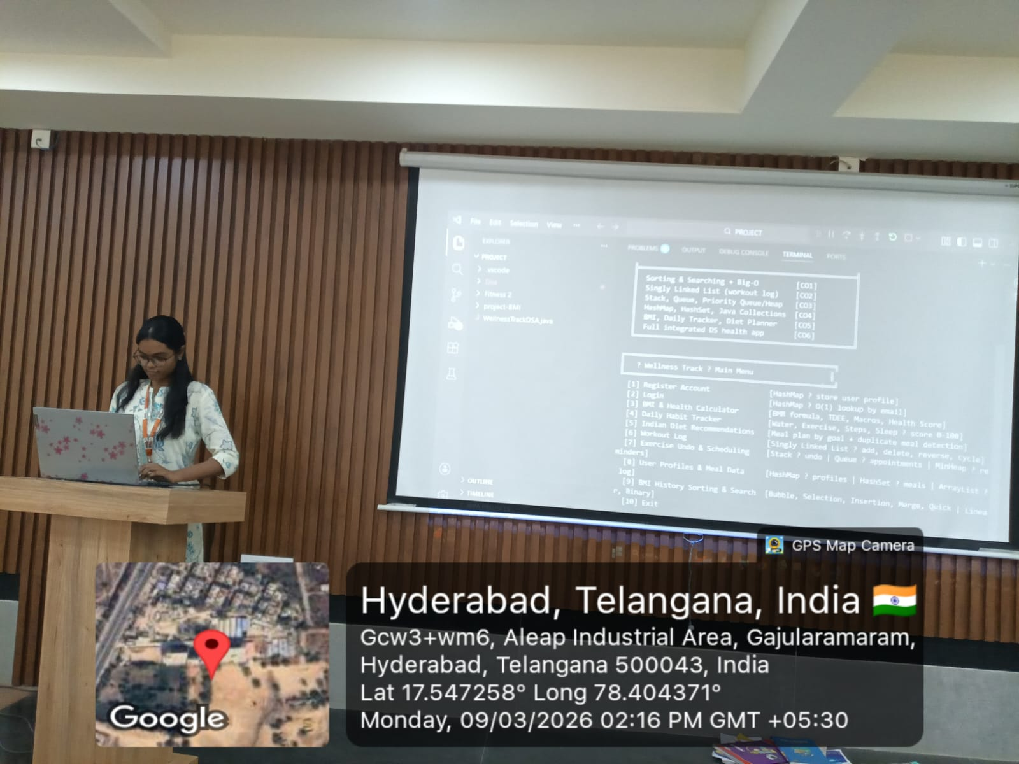

Slide 24
THANK YOU

